Slide 1

SPL-I Midterm Presentation
Prepared by
Md. Rayhan Islam Sefat
BSSE-1332
Topic: Personal Finance Management
Supervised by
Mr. Abdus Satter

Slide 2
Project Outline
“Personal Finance Management” project aims at making a synchronisation among three types of financial activities (earning, spending and saving) of a person as well as help the users to maintain his date wise as well as monthly and annual finance management and analyse the financial advantages and liabilities of the user for both short and long terms.

Slide 3
Languages
C
C++
Tools and concepts
Sorting and searching algorithms
Regression
Machine Learning

Slide 4
Features of the project
This is a software system that performs the following functions:
Taking input of the financial activities of user
Storing the data according to day, week, month and year
Calculating the savings period wise
Helps the users to prevent themselves from unnecessary spendings
Analyses the financial advantages and liabilities

Slide 5
The problems and challenges
Register System
Login System
Income Handling
Expense Handling
Savings Handling
Period Wise Activity Tracking
Regression Modeling

Slide 6
System root
Input System
Analysis Part
Earning
Spending
Savings tracker
Regression modeling

Slide 7
Progress till today

Slide 8
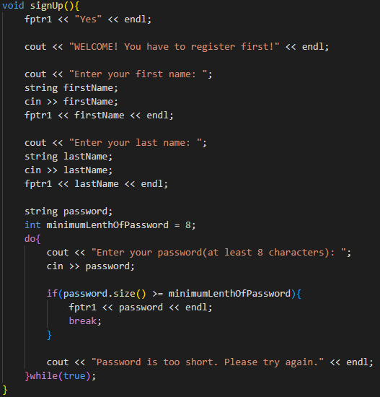
Register System
A register system will work when a user opens the software for the first time. It will take the following data as input:
First name
Last name
Password
Initial balance information
The data given by the users will be stored in a
file.

Slide 9
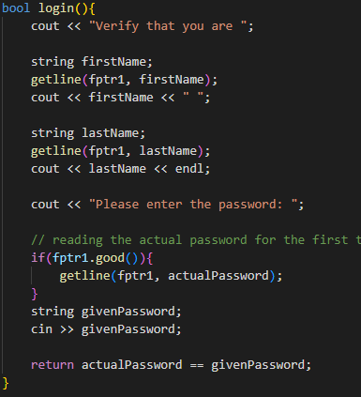
Login System
The users have to confirm their authentication every time they try to open the software by entering their password. The system will check if the current user has the right to access the information which were given earlier.

Slide 10
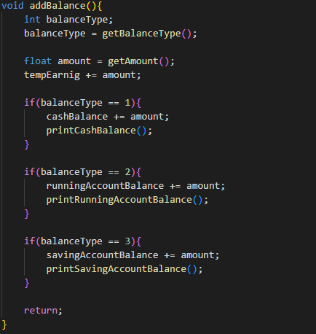
Balance Add & Transfer
The user can add balance as earnings and shift balance from one account to another. System will ensure if the user has enough balance to transfer before the transaction is performed.

Slide 11
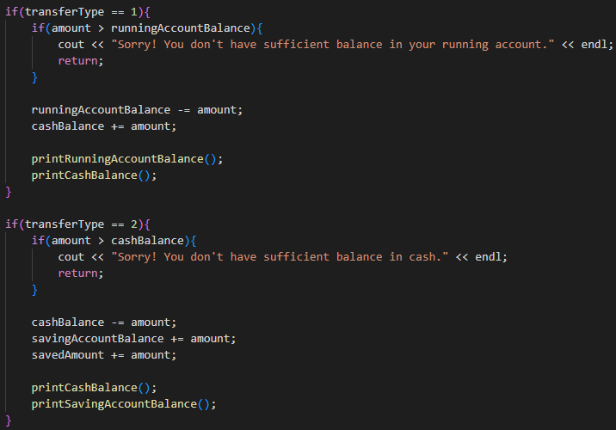

Slide 12
Expense Handling
The expenses have been divided into two parts. They are:
Need: This kind of expenses include basic needs like food, house rent, education etc.
Demand: This kind of expenses include things beyond basic needs like tour, gadgets etc.

Slide 13
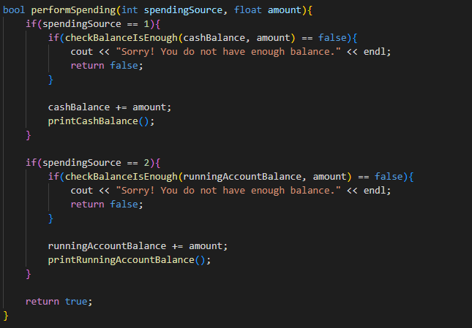

Slide 14
Challenge Handling Plans

Slide 15
Savings Handling
I will develop a module which will serve the users to maintain their savings for-
Short term
Long term
It will help users to be rich in the long run and ensure that he can plan for his retirement when he wants to.

Slide 16
Regression Modeling
This will be the most crucial part of my project where I will analyse the data of the user according to earning and spending habits and I will generate a regression model. I will compare this model with the ideal personal financial models like:
6 Jar Method by T. Harv Eker
50-30-20 Model by Elizabeth Warren

Slide 17
Thank You

